Slide 1
The Social Role of Design Representation
Dr. Susan Keller, Jennie Carroll
Proceedings of the 20th Australasian Conference of Information Systems, Monash University, Melbourne, Victoria, 2009

Slide 2
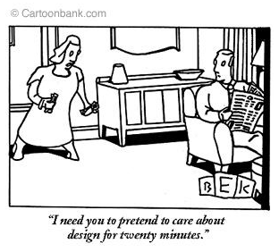
Agenda
Design representation – what is it?
Case studies
Social roles of representation
Takeaways for our use

Slide 3
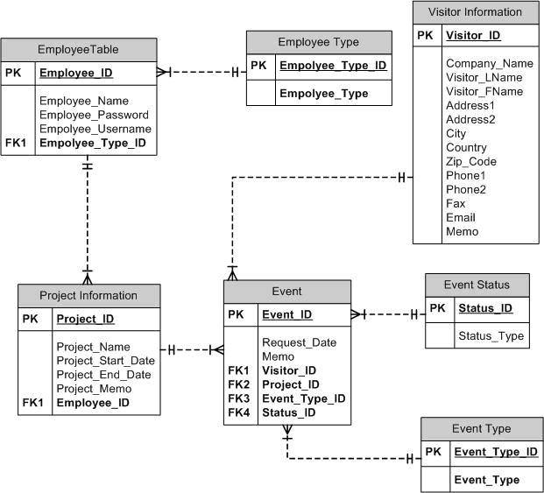
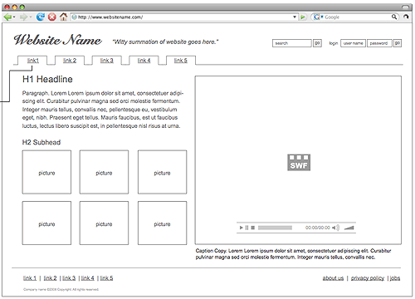
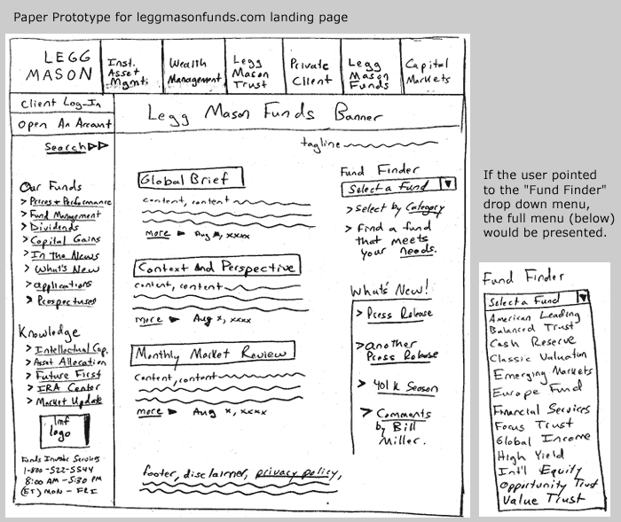
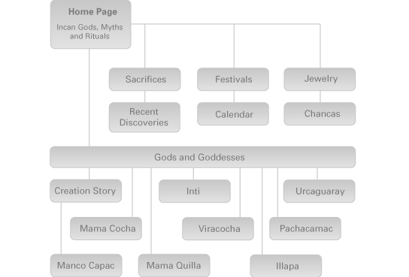
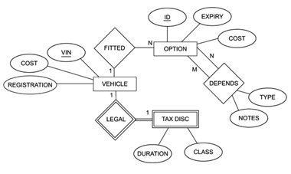
Design Representation
A perceptible expression of a design idea, proposal, or fact.
Saddler, 2001

Slide 4
Case Studies
Three companies
Design
Multimedia
Software
Interviews
Document analysis
Social rather than functional role

Slide 5
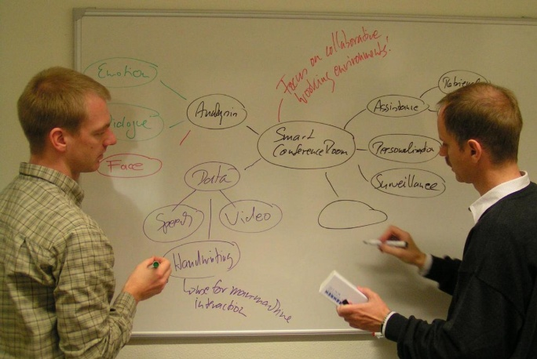
Cobblestone Designs
Convince the client that you can do the job
Face-to-face initial meeting with whiteboarding
Storyboards to focus on functionality
Preliminary graphic designs
ER diagrams to discuss data structure

Slide 6
Leading Light
Remove their interpretation and instill your interpretation
Interaction map created from client’s proposal
Wireframes show wording and functionality, not design
Visual concept presented in face-to-face meeting

Slide 7
Unique Designs
Moving between different types of representation deepens understanding
Paper-based prototyping
Computer-based mockups

Slide 8
Social role of representation
Selective focus
Downplay everything but what is of immediate interest
Focus | Representational Tactics
Textual content | Text is represented separately from design – client focuses on words, not other elements
Functionality/Navigation | No graphics, colors, or styles. Words only to reflect functionality – content is dummy text.
Graphic design/layout | Presented separately from other elements. Content is dummy text.

Slide 9
Social role of representation
Promotion
Representations crafted in ways that enhance the chance of promoting design ideas
Aim | Tactics/characteristics
Promote overall design concept | Face-to-face presentation. Professional, polished, low on detail, “what” not “how”.
Promote one aspect of the design | Controlled timing – do not distribute representations ahead of time. Aim is to instill designers’ interpretation.

Slide 10
Communication Model
By their nature, representations require extensive interpretation.
Schramm, 1954

Slide 11
Our Project

Slide 12
Cool Links
35 Excellent Wireframing Resources from Smashing Magazine

